Slide 1
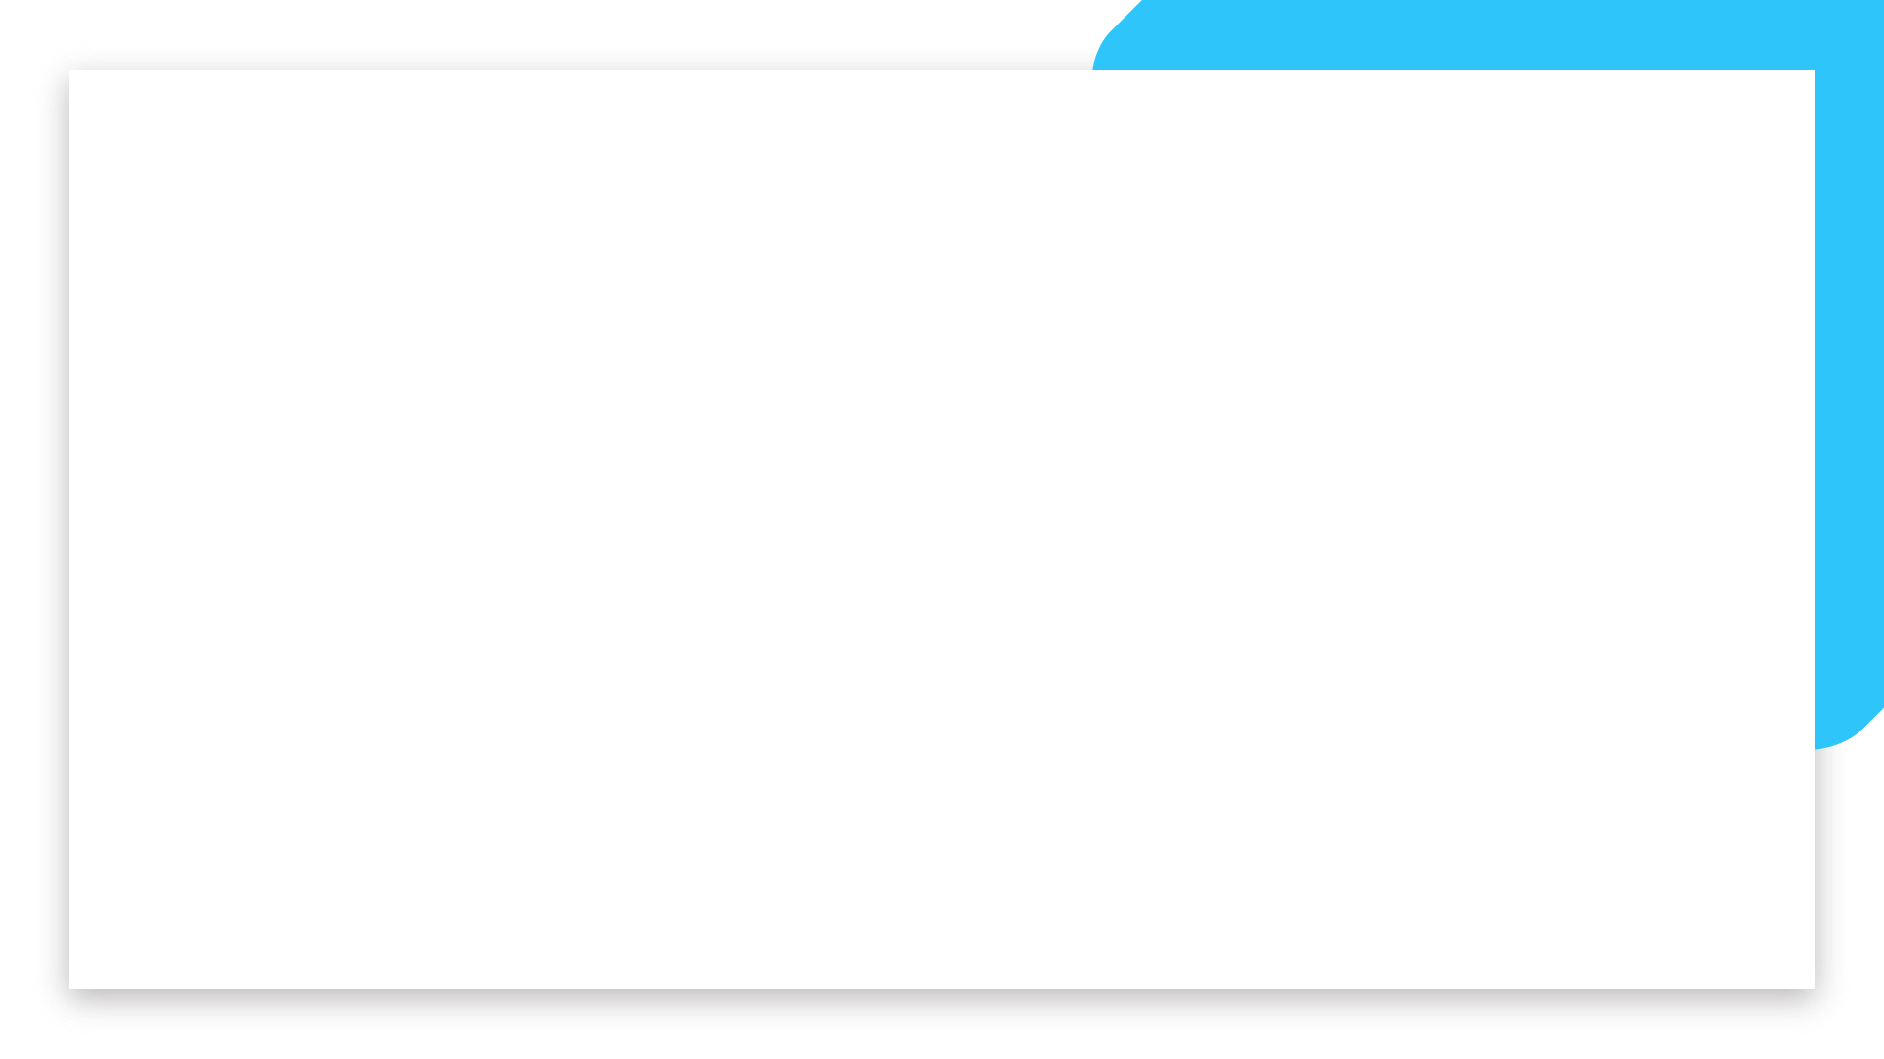

Transfer Learning
Welcome

Slide 2
What is Transfer Learning?
Transfer learning involves taking a pre-trained model, typically trained on a large and diverse dataset like ImageNet, and adapting it for a specific task. This method is particularly useful when the target dataset is smaller or lacks the diversity needed to train a high-performance model from scratch.
Welcome

Slide 3
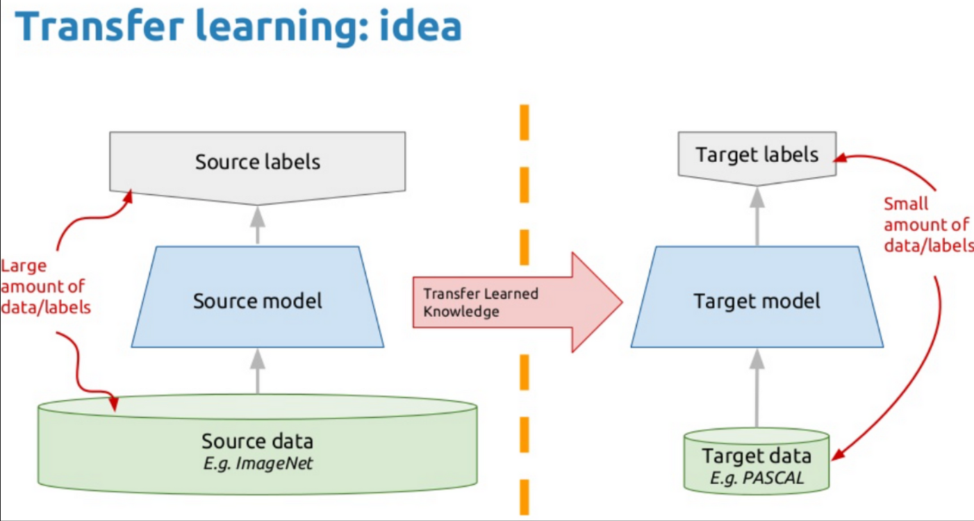
What is Transfer Learning?
Welcome

Slide 4
Key Concepts in Transfer Learning
Pre-trained Models: Models that have been previously trained on large datasets, such as VGG, ResNet, Inception, and DenseNet, have learned rich feature representations.
Feature Extraction: Using the pre-trained model as a fixed feature extractor. The model's earlier layers, which capture general features, are retained, while the final layers are replaced with new ones suitable for the target task.
Fine-Tuning: Adjusting the weights of the pre-trained model's layers along with the new layers. Fine-tuning can be done selectively, where only certain layers are updated to adapt the model to the new task.
Welcome

Slide 5
Imagenet
ImageNet is a large, widely-used dataset in the field of computer vision, especially for training and benchmarking deep learning models
ImageNet is a massive collection of labeled images designed for visual object recognition research.
It contains over 14 million images, each labeled with one or more categories.
ImageNet helped revolutionize deep learning in vision
Since then, models like VGG, ResNet, Inception, MobileNet, EfficientNet, etc., have been pretrained on ImageNet.
Welcome

Slide 6
Advantages of Transfer Learning in Computer Vision
Reduced Training Time: By leveraging pre-trained models, transfer learning significantly reduces the time required to train a model for a new task.
Improved Performance: Pre-trained models provide a strong starting point, often leading to better performance on the target task compared to training from scratch.
Lower Data Requirements: Transfer learning is particularly beneficial when the target dataset is small, as the pre-trained model's general features mitigate the need for large amounts of labeled data.
Welcome

Slide 7
Popular Pretrained Models
ResNet
VGG
Inception
MobileNet
EfficientNet
Welcome

Slide 8
Limitations of Transfer Learning in Computer Vision
Domain Mismatch: Transfer learning assumes that the features learned from the source domain (e.g., ImageNet) are applicable to the target domain. However, if there is a significant difference between the source and target domains, the pre-trained model may not perform well, and the transferred features might not be as useful.
Overfitting on Small Datasets: While transfer learning can help when the target dataset is small, there is still a risk of overfitting if the target dataset is too small to fine-tune the model properly. The model may memorize the training data instead of learning generalizable features.
Model Complexity and Size: Pre-trained models, especially those based on deep neural networks, are often large and complex. This can lead to increased computational and memory requirements, making it challenging to deploy these models on devices with limited resources.
Welcome

